Slide 1
Summer-q-camp3-quantum_Guardians
2D materials experiment

Slide 2
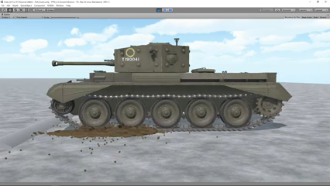
Person 1: Peeling off
front
back

Slide 3
Peeling off
1
a
Stick the tape to the belt
Spin the belt via lever a
It rolls over the belt and covers the belt surface
2
a
Parameter to calibrate: number of full rotations
of lever a to complete the loop.

Slide 4
Peeling off
3
a
Idea (tricky): having a blade here:
lever arm a moves down (z axis)
4
a
We have another piece of tape on the platform
with some graphite on it.
The belt assembly lowers down and sits on it.

Slide 5
Peeling off
5
a
Now I need to shift the whole green arm along
x axis, while rotating. Action from a and b
simultaneously.
b
z
y
x
6
a
We have another piece of tape on the platform
with some graphite on it.
The belt assembly lowers down and sits on it.

Slide 6
Peeling off
5
a
The belt assembly rolls to the right.
b
z
y
x
6
a

Slide 7
Peeling off
5
a
The belt assembly rolls to the right.
z
y
x
6
a

Slide 8
Peeling off
5
a goes up a little bit,
b shift along x a little bit, to make sure the two flakes come next to each other.
a
b
6
Repeat for 10 times back and forth to thin the graphite and perhaps be left with graphene at some parts.

Slide 9
Person 2: Exfoliation
The belt assembly and lever arm a is the same from the last step.
Through this x-y stage we would be able to on the substrates.
After the peeling off stage we just need to take the belt assembly apart and mount it on this setup.
x-y stage
a
Substrates

Slide 10
Person 3: Automated Imaging
Camera (auto zoom function)
Platform with actuators for 2D motion.
With micrometer resolution
Each slot is one 20x image,
Take image > move x μm along X axis> take another image > Then move along Y one slot and along X back to the left
Repeat until you cover the whole substrate
Then next slot for the next sample
20X

